Slide 1
Gender Recognition by Voice and Speech
Identifying the Gender of a Voice using Machine Learning
Capstone-3
Sristi Sharma
Springboard Data Science Career Track

Slide 2
Introduction
With increasing application of machine learning in nearly all day to day usability, voice analysis using ML is inevitably one of the most required one. Voice based security systems, recommendation systems, voice based devices are only a few straight use cases. Therefore, I am trying to design a model which can identify the important acoustic properties for a voice clip. Using the model, I should be able to predict and classify the voice to two genders i.e. male or female.

Slide 3
Data
The data set consists of 3168 samples, generated on different acoustic properties of voice. All samples are mapped to the gender of the voice and equally distributed for both the genders.
The following are few acoustic properties of voice which are measured:
meanfreq: mean frequency
sd: standard deviation of frequency
median: median frequency
Q25: first quantile
Q75: third quantile
IQR: interquantile range
skew: skewness
kurt: kurtosis
sp.ent: spectral entropy
sfm: spectral flatness
mode: mode frequency
centroid: frequency centroid

Slide 4
Data Exploration
. Density Plots
. Heatmaps
. Pair plots
Density plots: To see how column values are differentiating male and female.
Heatmaps: To see the correlation among all the columns.
Pair Plots: Created on highly correlated variable with the column ‘gender’.

Slide 5
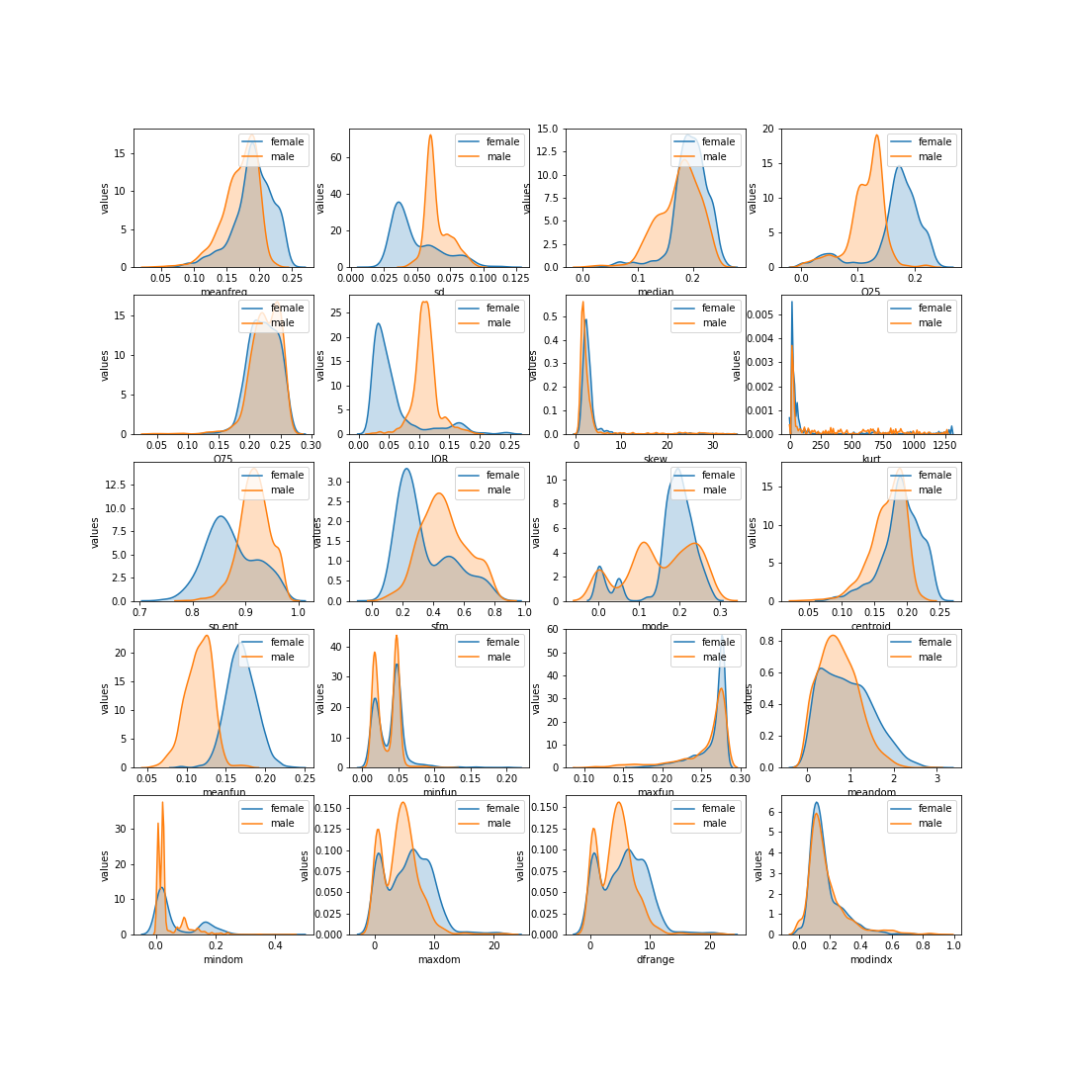
Data Exploration
Density Plots
Columns as ‘IQR’, ‘Q25’, ‘meanfun’, ‘sd’, ‘sp.ent’ are fairly differentiating male and female for the column ‘gender’.
Density plots

Slide 6
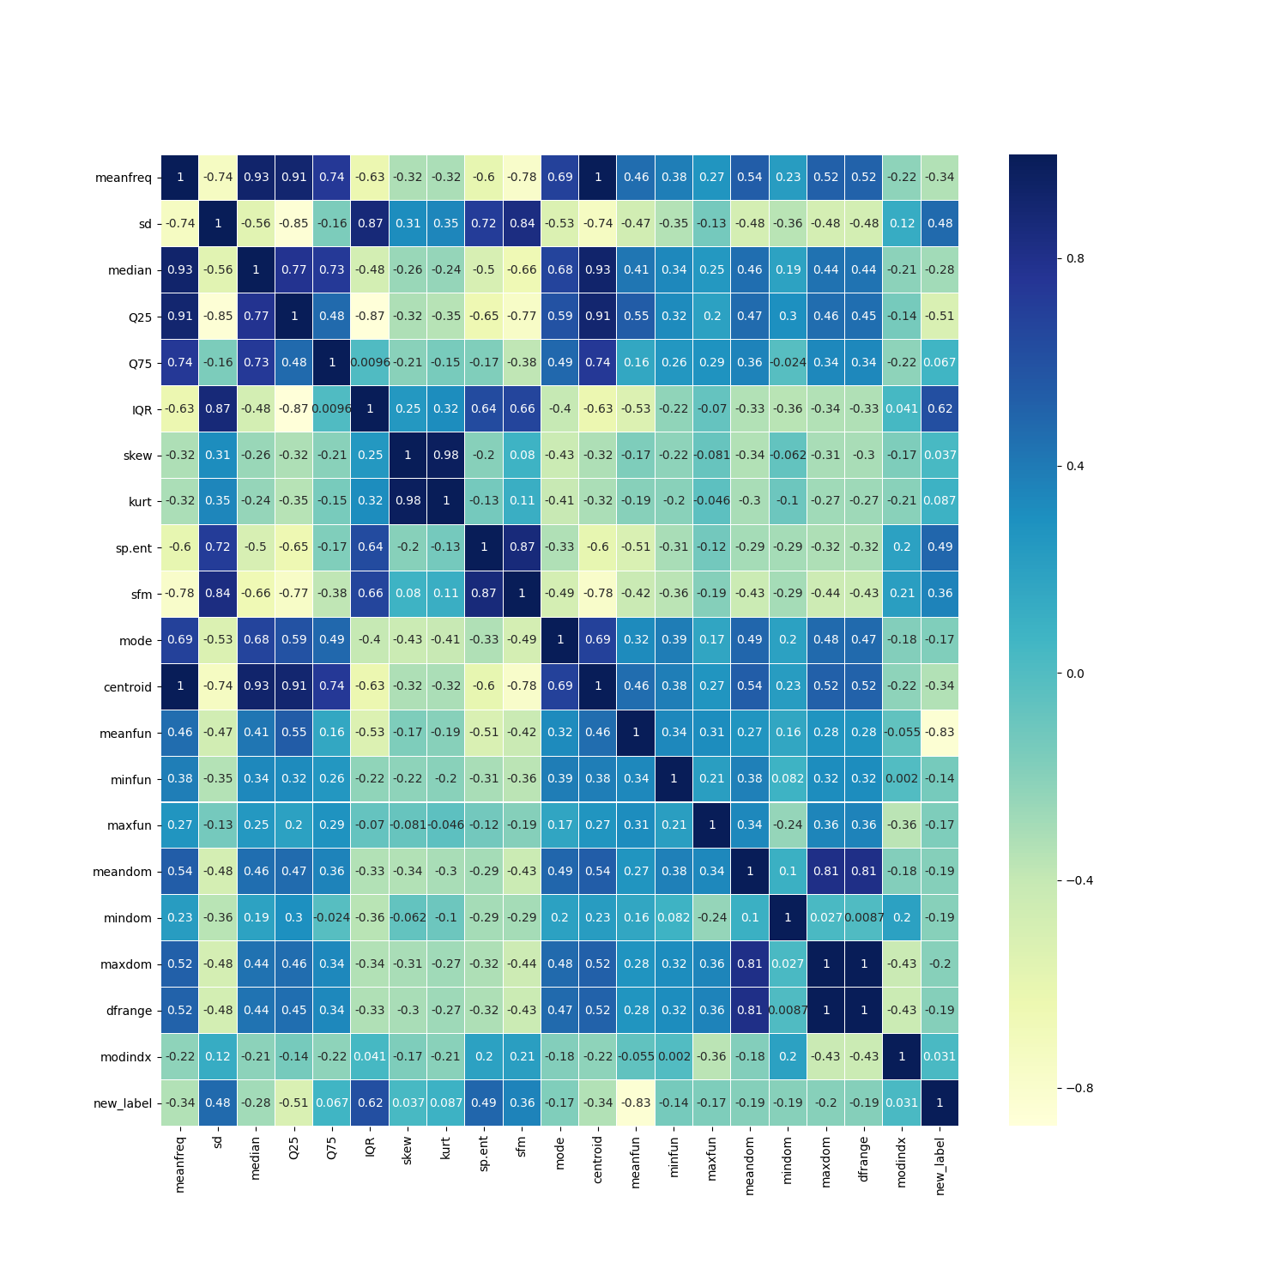
Data Exploration
Heatmap
The heatmap shows that there is a high correlation in the data and multicollinearity can be a problem while analysing the data.
Heatmap

Slide 7
Data Modeling
By applying various algorithms, this project is about selecting the best suitable algorithm for acoustic analysis.
Following are the algorithms used on preprocessed data.
Logistic Regression
Decision Tree
Random Forest
Support Vector Machine

Slide 8
Models Evaluation Metrics
Evaluation Metrics
 | Accuracy | Precision | Recall | F1 Score
Logistic Regression | 96.94 | 97.12 | 96.85 | 96.94
Decision Tree | 96.85 | 97.56 | 96.29 | 96.85
Random Forest | 97.90 | 98.32 | 97.59 | 97.90
SVM | 98.18 | 98.33 | 98.14 | 98.18

Slide 9
Conclusion
All investigated methods Logistic Regression, Decision Tree, Random Forest and SVM have shown high accuracy which is >96% on this data but SVM model turns out to be the best model. The accuracy of the SVM model is highest which is 98.18%. Along with the highest F1 Score.

Slide 10
Future Exploration
I would like to extend the model to a recommendation system for recommending answers based on the questions asked by either male or female.

Slide 11
Thank You

